Slide 1
DIFFERNCE BETWEEN TIGHTLY AND LOOSELY COUPLED MULTIPROCESSOR
1)Tightly coupled
Multiprocessor systems contain multiple CPUs that are connected at the bus level. These CPUs may have access to a central shared memory (SMP or UMA), or may participate in a memory hierarchy with both local and shared memory (NUMA).
1)Loosely-coupled multiprocessor system(often referred to as clusters) are based on multiple standalone single or dual process or commodity computers interconnected via a high speed communication system .

Slide 2
2) Tightly-coupled systems perform better & are physically smaller than loosely-coupled system
3) More expensive.
4) In a tightly-coupled system, the delay Experienced , when a message is sent from one computer to another is short and data rate is high; that is, the number of bits per second that can be transferred is large.
(2) Loosely coupled system is just Opposite of tightly coupled system.
3) Less expensive.
(4)In a loosely-coupled system, the opposite is true: The inter-machine message delay is large and the data rate is low.

Slide 3
5) For example, two CPU chips on the same printed circuit board and connected by wire etched onto the board are likely to be tightly Coupled.
5) For example two computers connected by a2400 bit/sec modem over the telephone system are certain to be loosely coupled.

Slide 4
(6) Tightly-coupled systems tend to be much more energy efficient than clusters. This is because considerable economies can be realized by designing components to work together from the beginning in tightly-coupled systems.
(6)loosely-coupled systems use components that were not necessarily intended specifically for use in such systems.

Slide 5
Multiprocessor System
  It is system ,with a single operating system, which coordinates various processor activities either through shared memory or inter processor messages.

Slide 6
Types of Multiprocessors
There are two types of multiprocessors on the way their memory is organized.
1.Tightly coupled multiprocessors.
2.loosely coupled multiprocessors.

Slide 7
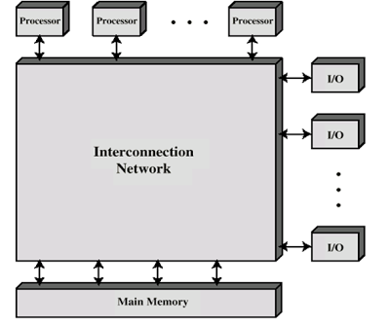
1.Tightly coupled multiprocessors

Slide 8
In tightly coupled main memory is shared by all processors i.e. “HIGH DEGREE OF RESOURCE SHARING”.
This is used to speed up the execution of a single large program in time critical operations.
all processors share main memory &access to I/O devices and are interconnected by a bus.
Entire system is controlled by single O.S. that provides interaction between processors & their programs at the job ,task , file and data element levels.

Slide 9
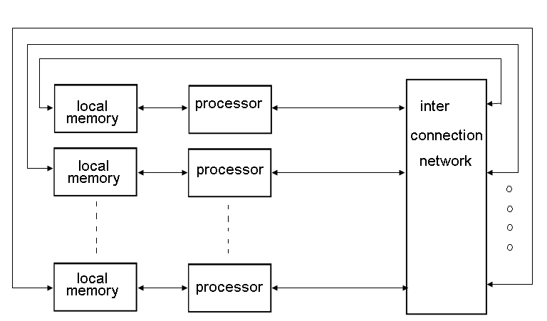
2.Loosely coupled multiprocessors

Slide 10
In loosely coupled multiprocessor each processor has its own memory (i.e. faster access to its local or own memory).
processor interact through interconnection structure or by message passing using standard primitive functions send() & receive().
The access to remote memory attached to other processors takes longer time due to added delay through the interconnection network.
It is characterized by non-uniform memory access time.
It is easier to organize & write operating system for loosely coupled systems.

